Slide 1
Audit of financial statements: from raw into intelligent
Master thesis
Motivation. Experiments
Aleksei Maliutin
Supervisors at UvA:
Marcel Boersma
Research Scientist, UvA Institute for Advanced Study
Sumit Sourabh
Research Scientist, UvA Institute for Advanced Study
Supervisor at ITMO:
Dr. Valeria V. Krzhizhanovskaya
Associate Professor, ITMO University, Russia
Senior Researcher, University of Amsterdam
Amsterdam
8/03/2019

Slide 2
﻿Similarity between language modeling and network modeling
Natural language
Student reads the book about wild nature in Russia
– grammar and semantic are correct
– logically correct (make sense)
Construct pairs
('Student', 'reads’),
('Student', 'the’),
('Student', 'book')
('reads', 'Student’),
('reads', 'the’),
('reads', 'book’),
('reads', 'about'),
('Russia', 'wild’),
('Russia', 'nature’),
('Russia', 'in')
…
These pairs make sense and logically correct

Slide 3
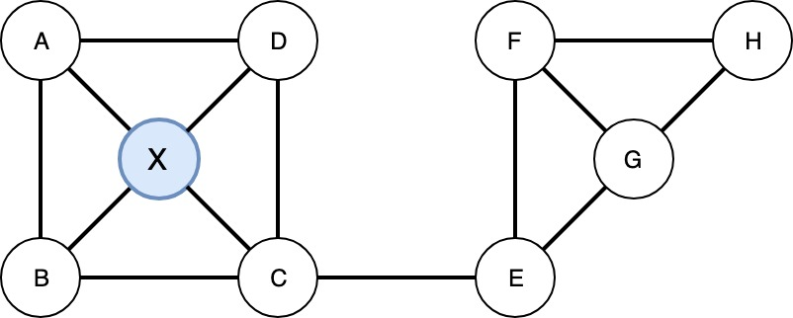
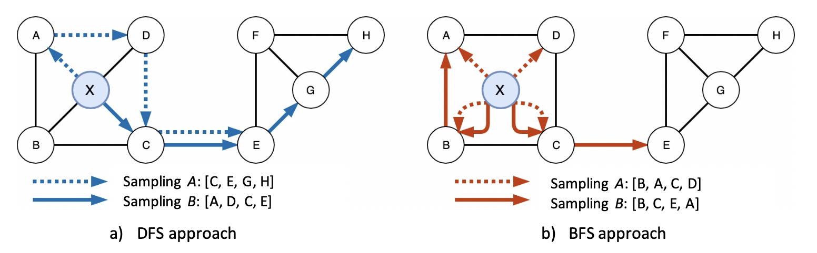
﻿Similarity between language modeling and network modeling
Natural language
Network
Student reads the book about wild nature in Russia
– grammar and semantic are correct
– logically correct (make sense)
NO explicit order in general case
Construct pairs
– node types could differ
– edges could have unequal meaning
('Student', 'reads’),
('Student', 'the’),
('Student', 'book')
('reads', 'Student’),
('reads', 'the’),
('reads', 'book’),
('reads', 'about'),
('Russia', 'wild’),
('Russia', 'nature’),
('Russia', 'in')
…
One needs sampling technique
These pairs make sense and logically correct

Slide 4
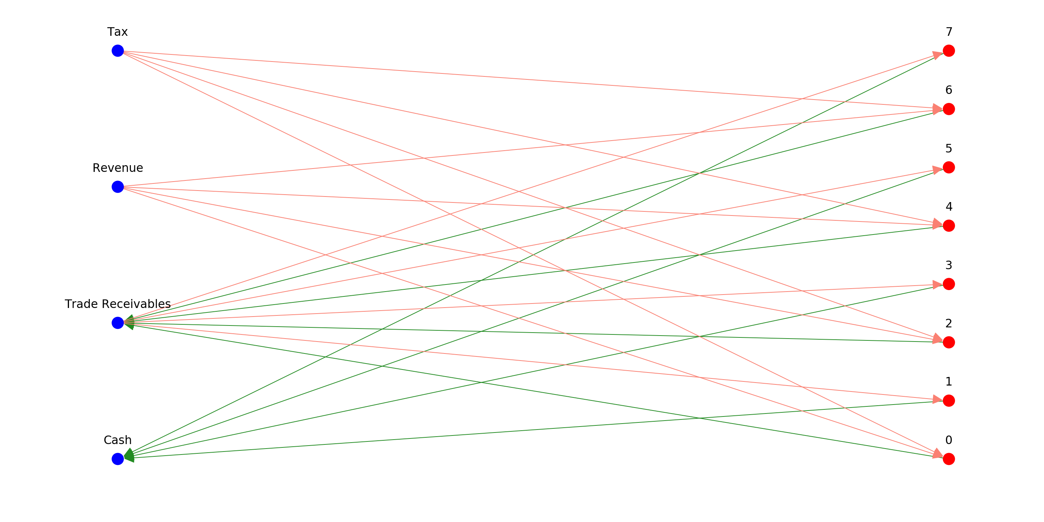
Experimental Setup
A combination of Sales and Collection business processes with noise in coefficients
ID | Name | Debit | Credit
0 | Revenue | 0.0 | 0.910881
0 | Tax | 0.0 | 0.089119
0 | Trade Receivables | 1.0 | 0.000000
1 | Trade Receivables | 0.0 | 1.000000
1 | Cash | 1.0 | 0.000000
2 | Revenue | 0.0 | 0.938945
2 | Tax | 0.0 | 0.061055
2 | Trade Receivables | 1.0 | 0.000000
3 | Trade Receivables | 0.0 | 1.000000
3 | Cash | 1.0 | 0.000000
4 | Revenue | 0.0 | 0.776770
4 | Tax | 0.0 | 0.223230
4 | Trade Receivables | 1.0 | 0.000000
5 | Trade Receivables | 0.0 | 1.000000
5 | Cash | 1.0 | 0.000000
6 | Revenue | 0.0 | 0.794639
6 | Tax | 0.0 | 0.205361
6 | Trade Receivables | 1.0 | 0.000000
7 | Trade Receivables | 0.0 | 1.000000
7 | Cash | 1.0 | 0.000000

Slide 5
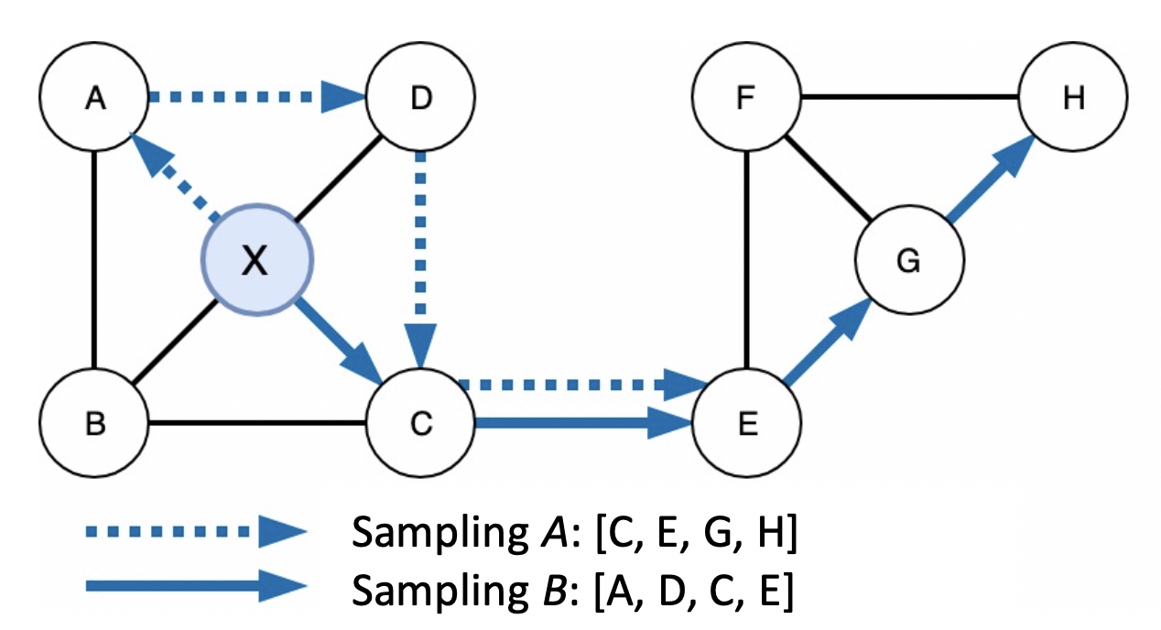
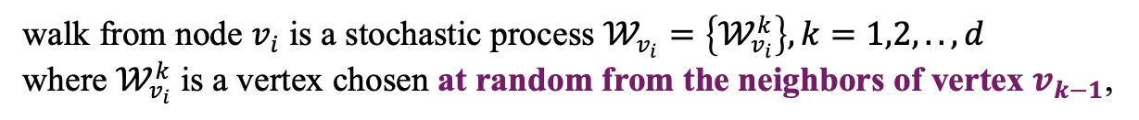
RandomWalk
walk from node $v_{i}$ is a stochastic process $𝒲_{v_{i}}=\left\{𝒲_{v_{i}}^{k}\right\}, k=1,2,.., d$
where $𝒲_{v_{i}}^{k}$ is a vertex chosen at random from the neighbors of vertex $v_{k−1}$,
– always follows the direction of edge
– uniform transition probability
– DFS nature
0.25
0.25
Example:
start from node 0, OUT direction
0.25
! One cannot robustly sample
with RandomWalk
0.25
?

Slide 6
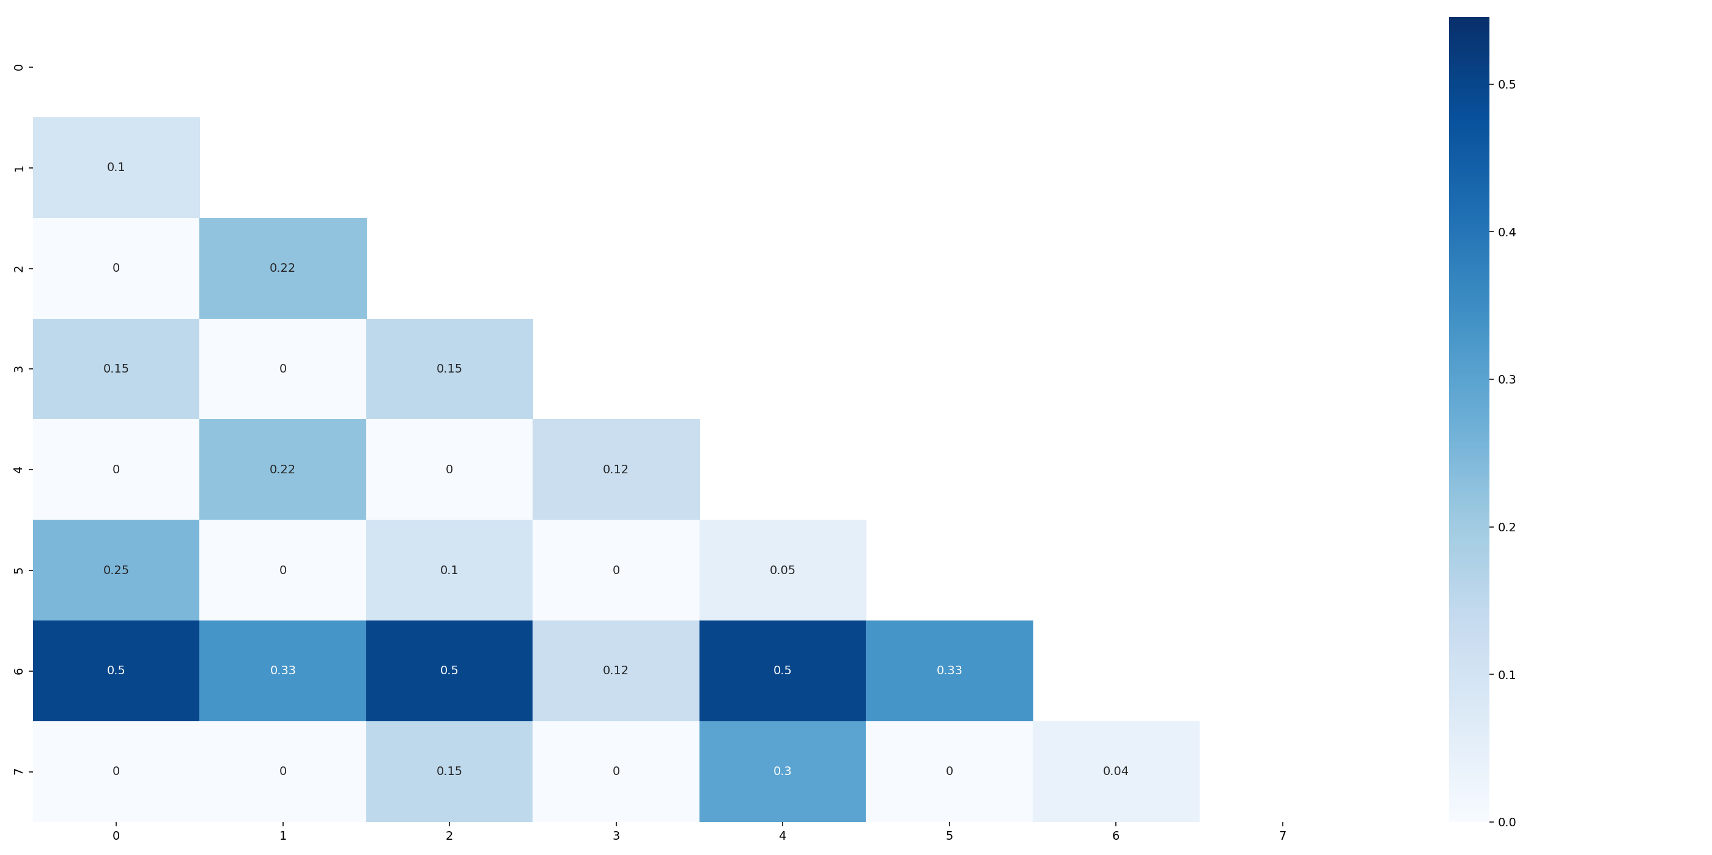
RandomWalk
walk from node $v_{i}$ is a stochastic process $𝒲_{v_{i}}=\left\{𝒲_{v_{i}}^{k}\right\}, k=1,2,.., d$
where $𝒲_{v_{i}}^{k}$ is a vertex chosen at random from the neighbors of vertex $v_{k−1}$,
– always follows the direction of edge
– uniform transition probability
– DFS nature

Slide 7
Meta-path version: BP$→$FA$←$BP
walk from node $v_{i}$ is a stochastic process $𝒲_{v_{i}}=\left\{𝒲_{v_{i}}^{k}\right\}, k=1,2,.., d$
where $𝒲_{v_{i}}^{k}$ is a vertex chosen at random from the neighbors of vertex $v_{k−1}$which are follows the relationship in schema.
– logically correct for FSN
– uniform transition probability
– DFS nature
0.33
0.33
Example:
start from node 0, OUT direction
0.33
0, 4
0.33
0.33
0, 4, 2
etc.
0.33

Slide 8
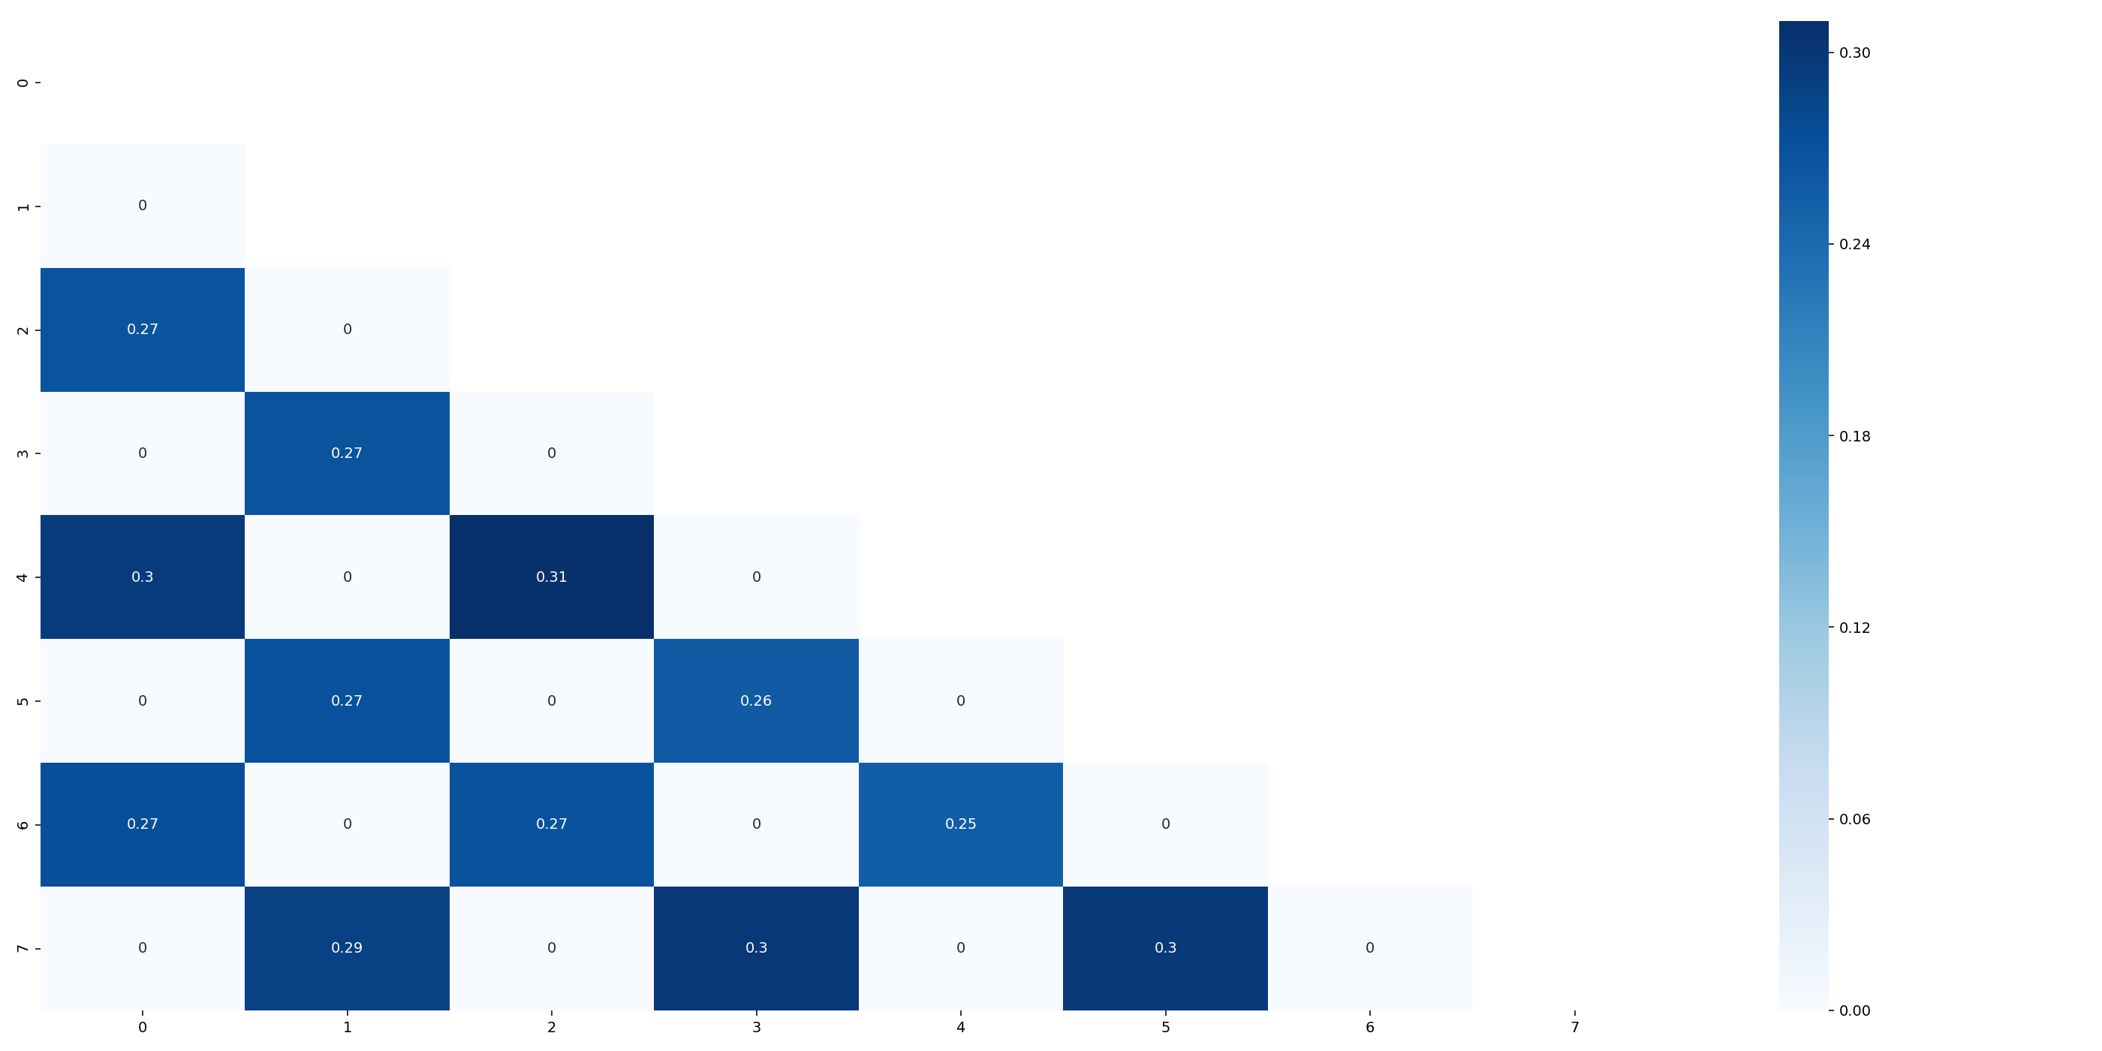
Meta-path version: BP$→$FA$←$BP
walk from node $v_{i}$ is a stochastic process $𝒲_{v_{i}}=\left\{𝒲_{v_{i}}^{k}\right\}, k=1,2,.., d$
where $𝒲_{v_{i}}^{k}$ is a vertex chosen at random from the neighbors of vertex $v_{k−1}$which are follows the relationship in schema.
– logically correct for FSN
– uniform transition probability
– DFS nature
+ capture the main differences in BPs

Slide 9
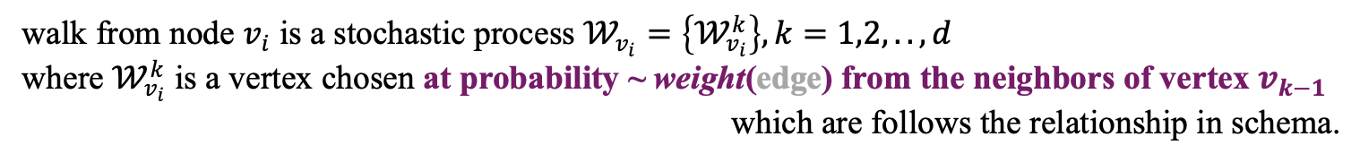
Meta-path version: BP$→$FA$←$BP, weighted transition probability
walk from node $v_{i}$ is a stochastic process $𝒲_{v_{i}}=\left\{𝒲_{v_{i}}^{k}\right\}, k=1,2,.., d$
where $𝒲_{v_{i}}^{k}$ is a vertex chosen at probability ~ weight(edge) from the neighbors of vertex $v_{k−1}$
which are follows the relationship in schema.
0.1
0.1
– logically correct for FSN
– encourage to explore rich regions
– DFS nature
0.32
0.32
0.9
0.9
Example:
start from node 0, IN direction
0.31
0.30
0, 2
0.38
0, 2, 0
etc.
0.37

Slide 10
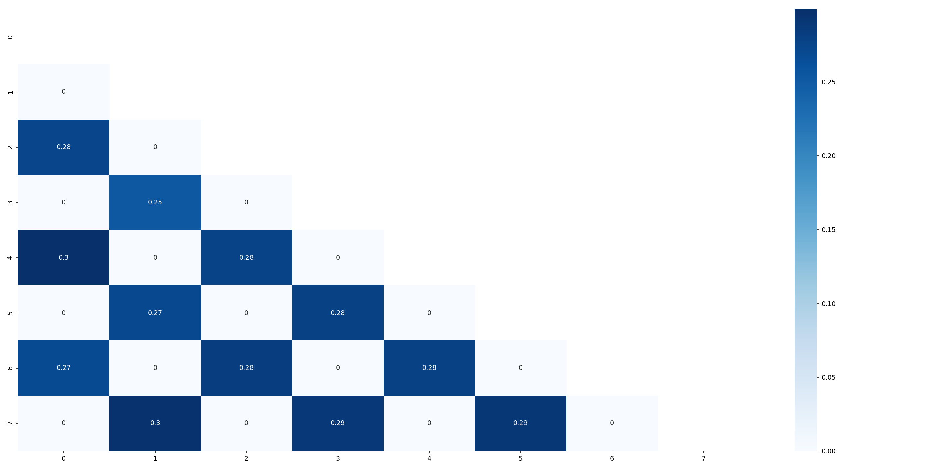
Meta-path version: BP$→$FA$←$BP, weighted transition probability
walk from node $v_{i}$ is a stochastic process $𝒲_{v_{i}}=\left\{𝒲_{v_{i}}^{k}\right\}, k=1,2,.., d$
where $𝒲_{v_{i}}^{k}$ is a vertex chosen at probability ~ weight(edge) from the neighbors of vertex $v_{k−1}$
which are follows the relationship in schema.
– logically correct for FSN
– encourage to explore rich regions
– DFS nature
Example:
start from node 0, IN direction

Slide 11
Meta-path version: BP$→$FA$←$B modified with lowest diffs
walk from node $v_{i}$ is a stochastic process $𝒲_{v_{i}}=\left\{𝒲_{v_{i}}^{k}\right\}, k=1,2,.., d$
where $𝒲_{v_{i}}^{k}$ is a vertex chosen at probability ~ weight(edge) from the neighbors of vertex $v_{k−1}$
which are follows the relationship in schema.
0.1
0.1
– logically correct for FSN
– encourage to explore similar regions
– DFS nature
0.22
0.22
0.9
0.9
Example:
start from node 0, IN direction
0.18
0.21
0, 2
0.60
0, 2, 0
etc.
0.57

Slide 12
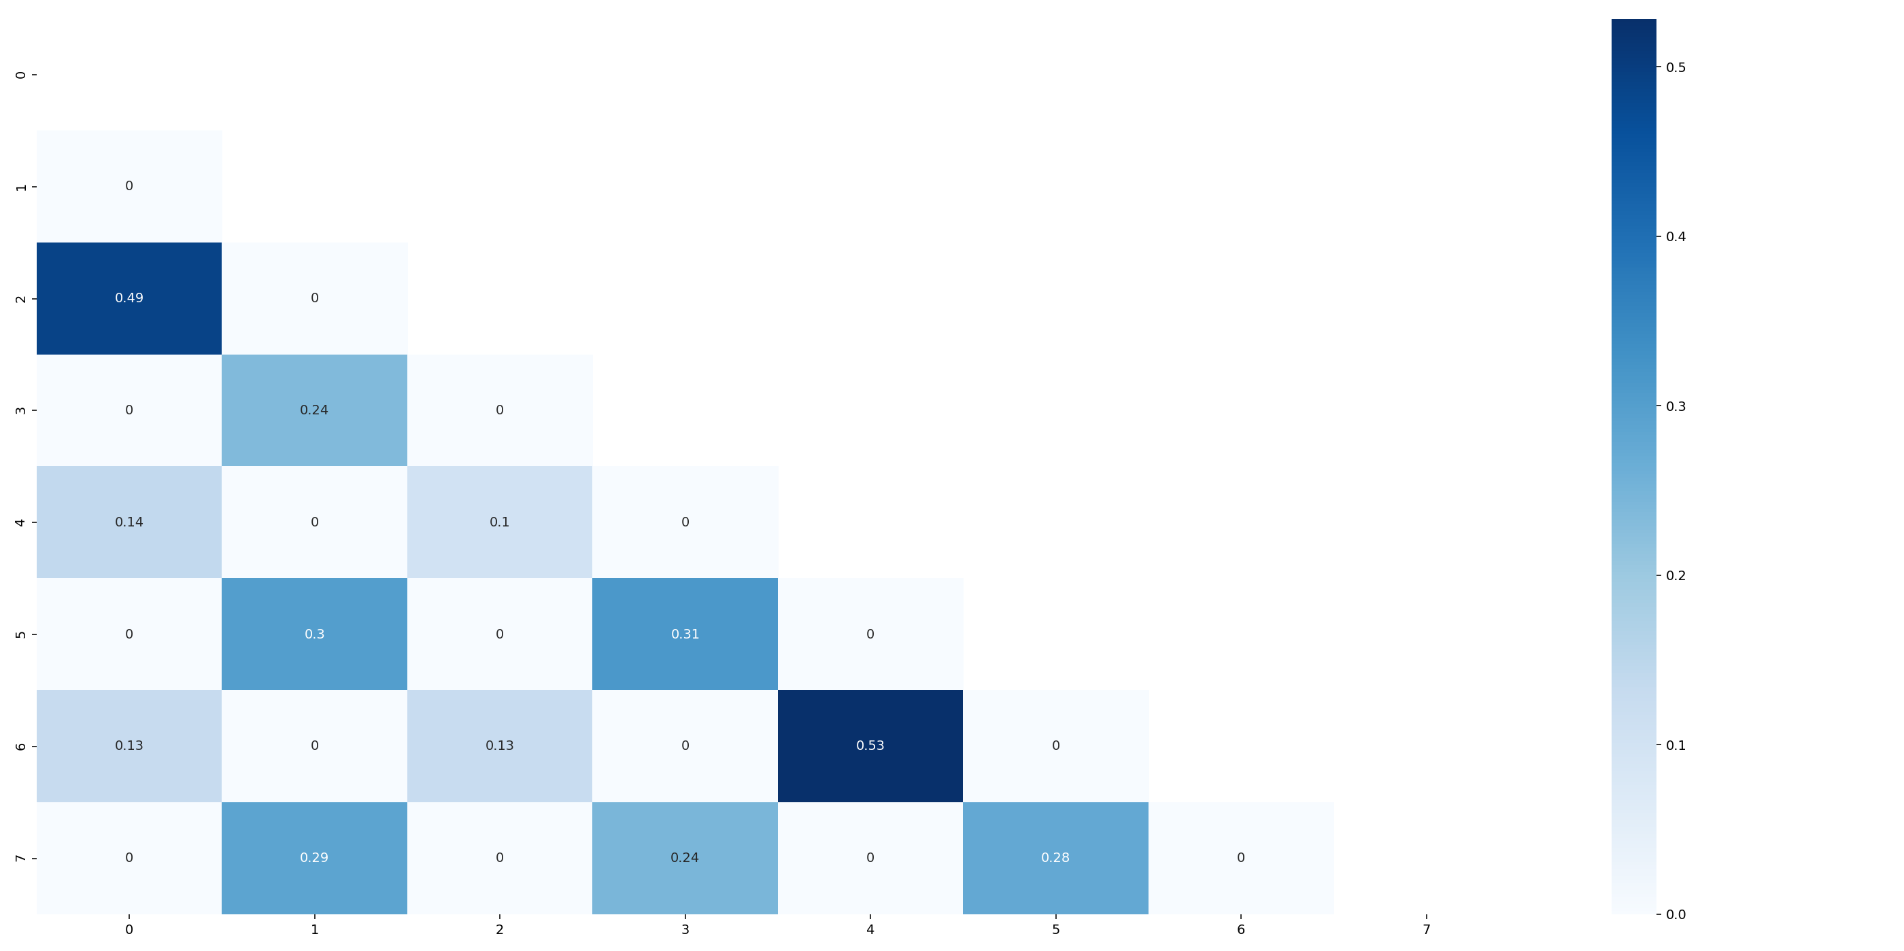
Meta-path version: BP$→$FA$←$B modified with lowest diffs
walk from node $v_{i}$ is a stochastic process $𝒲_{v_{i}}=\left\{𝒲_{v_{i}}^{k}\right\}, k=1,2,.., d$
where $𝒲_{v_{i}}^{k}$ is a vertex chosen at probability ~ weight(edge) from the neighbors of vertex $v_{k−1}$
which are follows the relationship in schema.
– logically correct for FSN
– encourage to explore similar regions
– DFS nature
Example:
start from node 0, IN direction

Slide 13
Next meeting:
15th of March, 2019

